Slide 1
What gets backed up
Red Hat OpenShift Cluster
CP4D is a stateful application
Backup and restore should be Application and Crash Consistent
CP4D Related Namespaces
StoragePool
Secret
Deployment
CP4D Backup and Restore Scope
All resources and PVCs in CP4D used namespace (Green block in “CP4D Related Namespaces”)
CRs and CRDs, used by CP4D at OCP level (bold green curved connector)
Namespace scoped resource (Green block aside of etcd)
CR
Job
ClusterRole
Ref of
Pod
Pod
ConfigMap
DaemonSet
CR
CRD
Service
PVC
StatefulSet
Container Image Repo (JFrog) Backup and Restore
It is expected that container repositories such as JFrog Artefactory used in the bank should have the necessary Backup and Restore capabilities
Node
Namespace scoped resource
etcd
PV
Vol
Cluster scoped resource

Slide 2
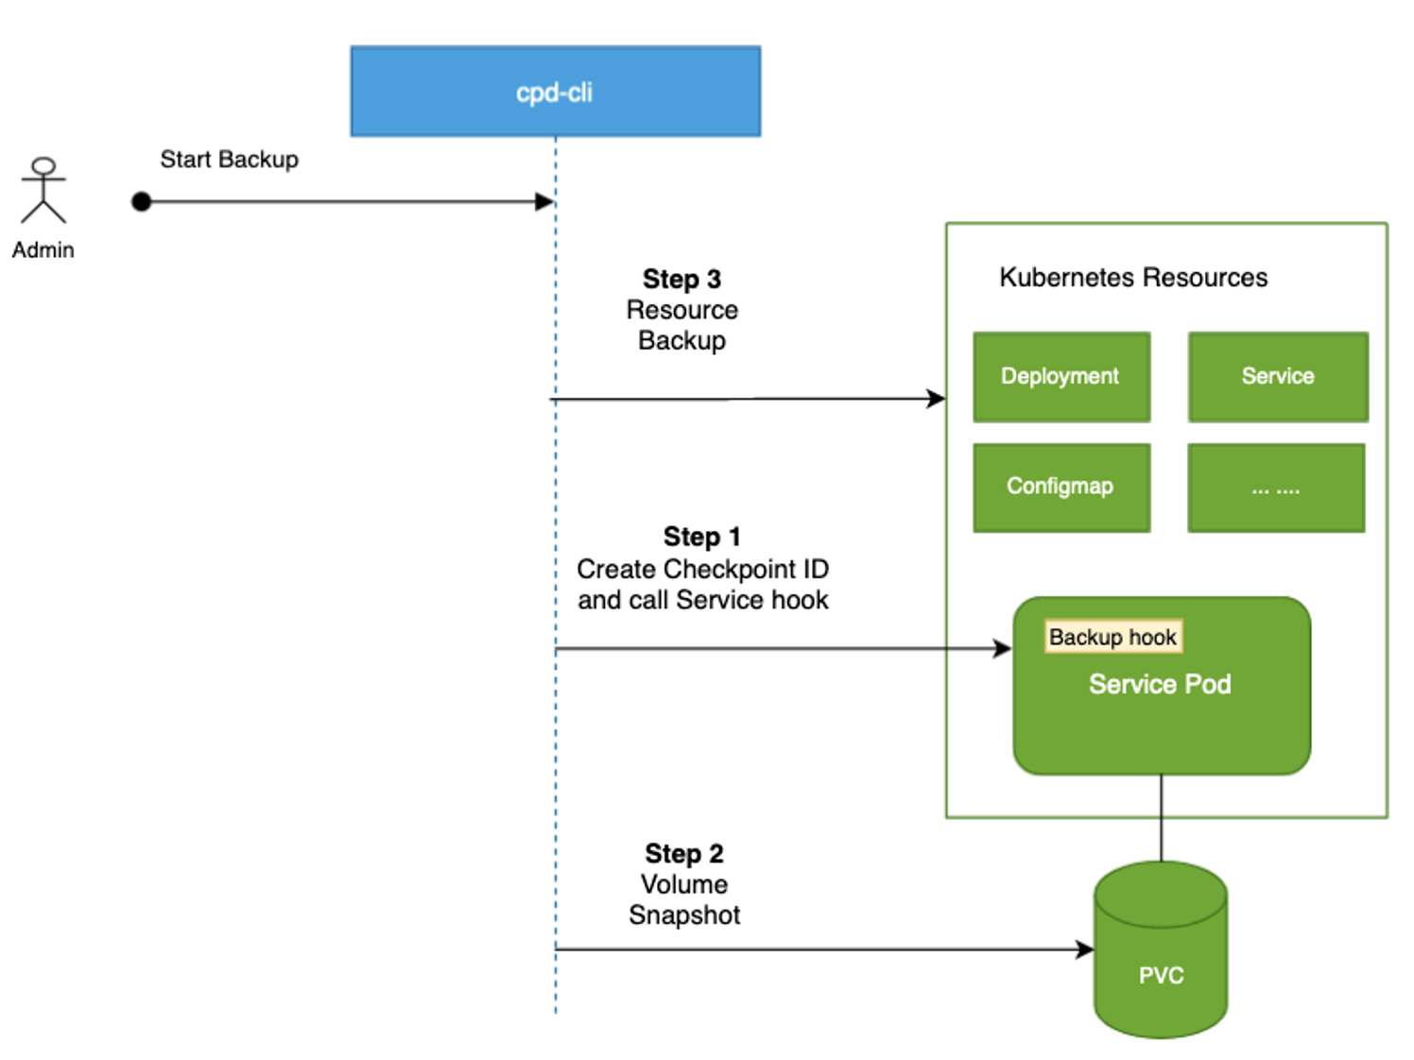
What do we mean by CP4D Application and Crash Consistent
Cloud Pak for Data implements application (service) consistent backup, which provides solution to the typical problem that the application (service) data in memory or any pending I/O operations is not captured during a backup
Invokes services’ hook to let services persist their data into volume (on the PVC) before backup. It’s to ensure service consistency
Leverages Container Storage Interface (CSI) volume snapshot for PVC backup. It allows a faster (incremental backup), data safe-guarded backup with zero cluster downtime.

Slide 3
Backup and Restore Conceptual Architecture
Pre-requisite is that JFrog repo (container images) are backed up. This support must come outside of our solution
Application and Crash consistent Backup (in Object Storage)
Application Metadata (Metadata information of all Kubernetes Information such as Deployments, Pods, PVCs and others
Backup of PVC Data – the CSI Snapshots
Backup
Restore
CP4D Related Namespaces
Storage Fusion (SF)
CP4D
Storage Fusion (SF)
Other Kubernetes related resources such as Service, Routes and others
OADP Capabilities
ODF Capabilities
OADP Capabilities
ODF Capabilities
CP4D Services
CP4D Services
…
User Workload
…
CP4D Services
CP4D Services
…
OADP Operators
OADP Pods
ODF Operators
ODF Pods
OADP Operators
OADP Pods
ODF Operators
ODF Pods
PVC
PVC
PVC
PVC
PVC
PVC
PVC
PVC
PV
PV
PVC
PV
PV
CSI Interface through OpenShift Data Foundation (ODF) for Kubernetes Native Storage
CSI Interface for ODF
PV
PV
PV
OpenShift Primary Cluster
OpenShift Restore Cluster

Slide 4
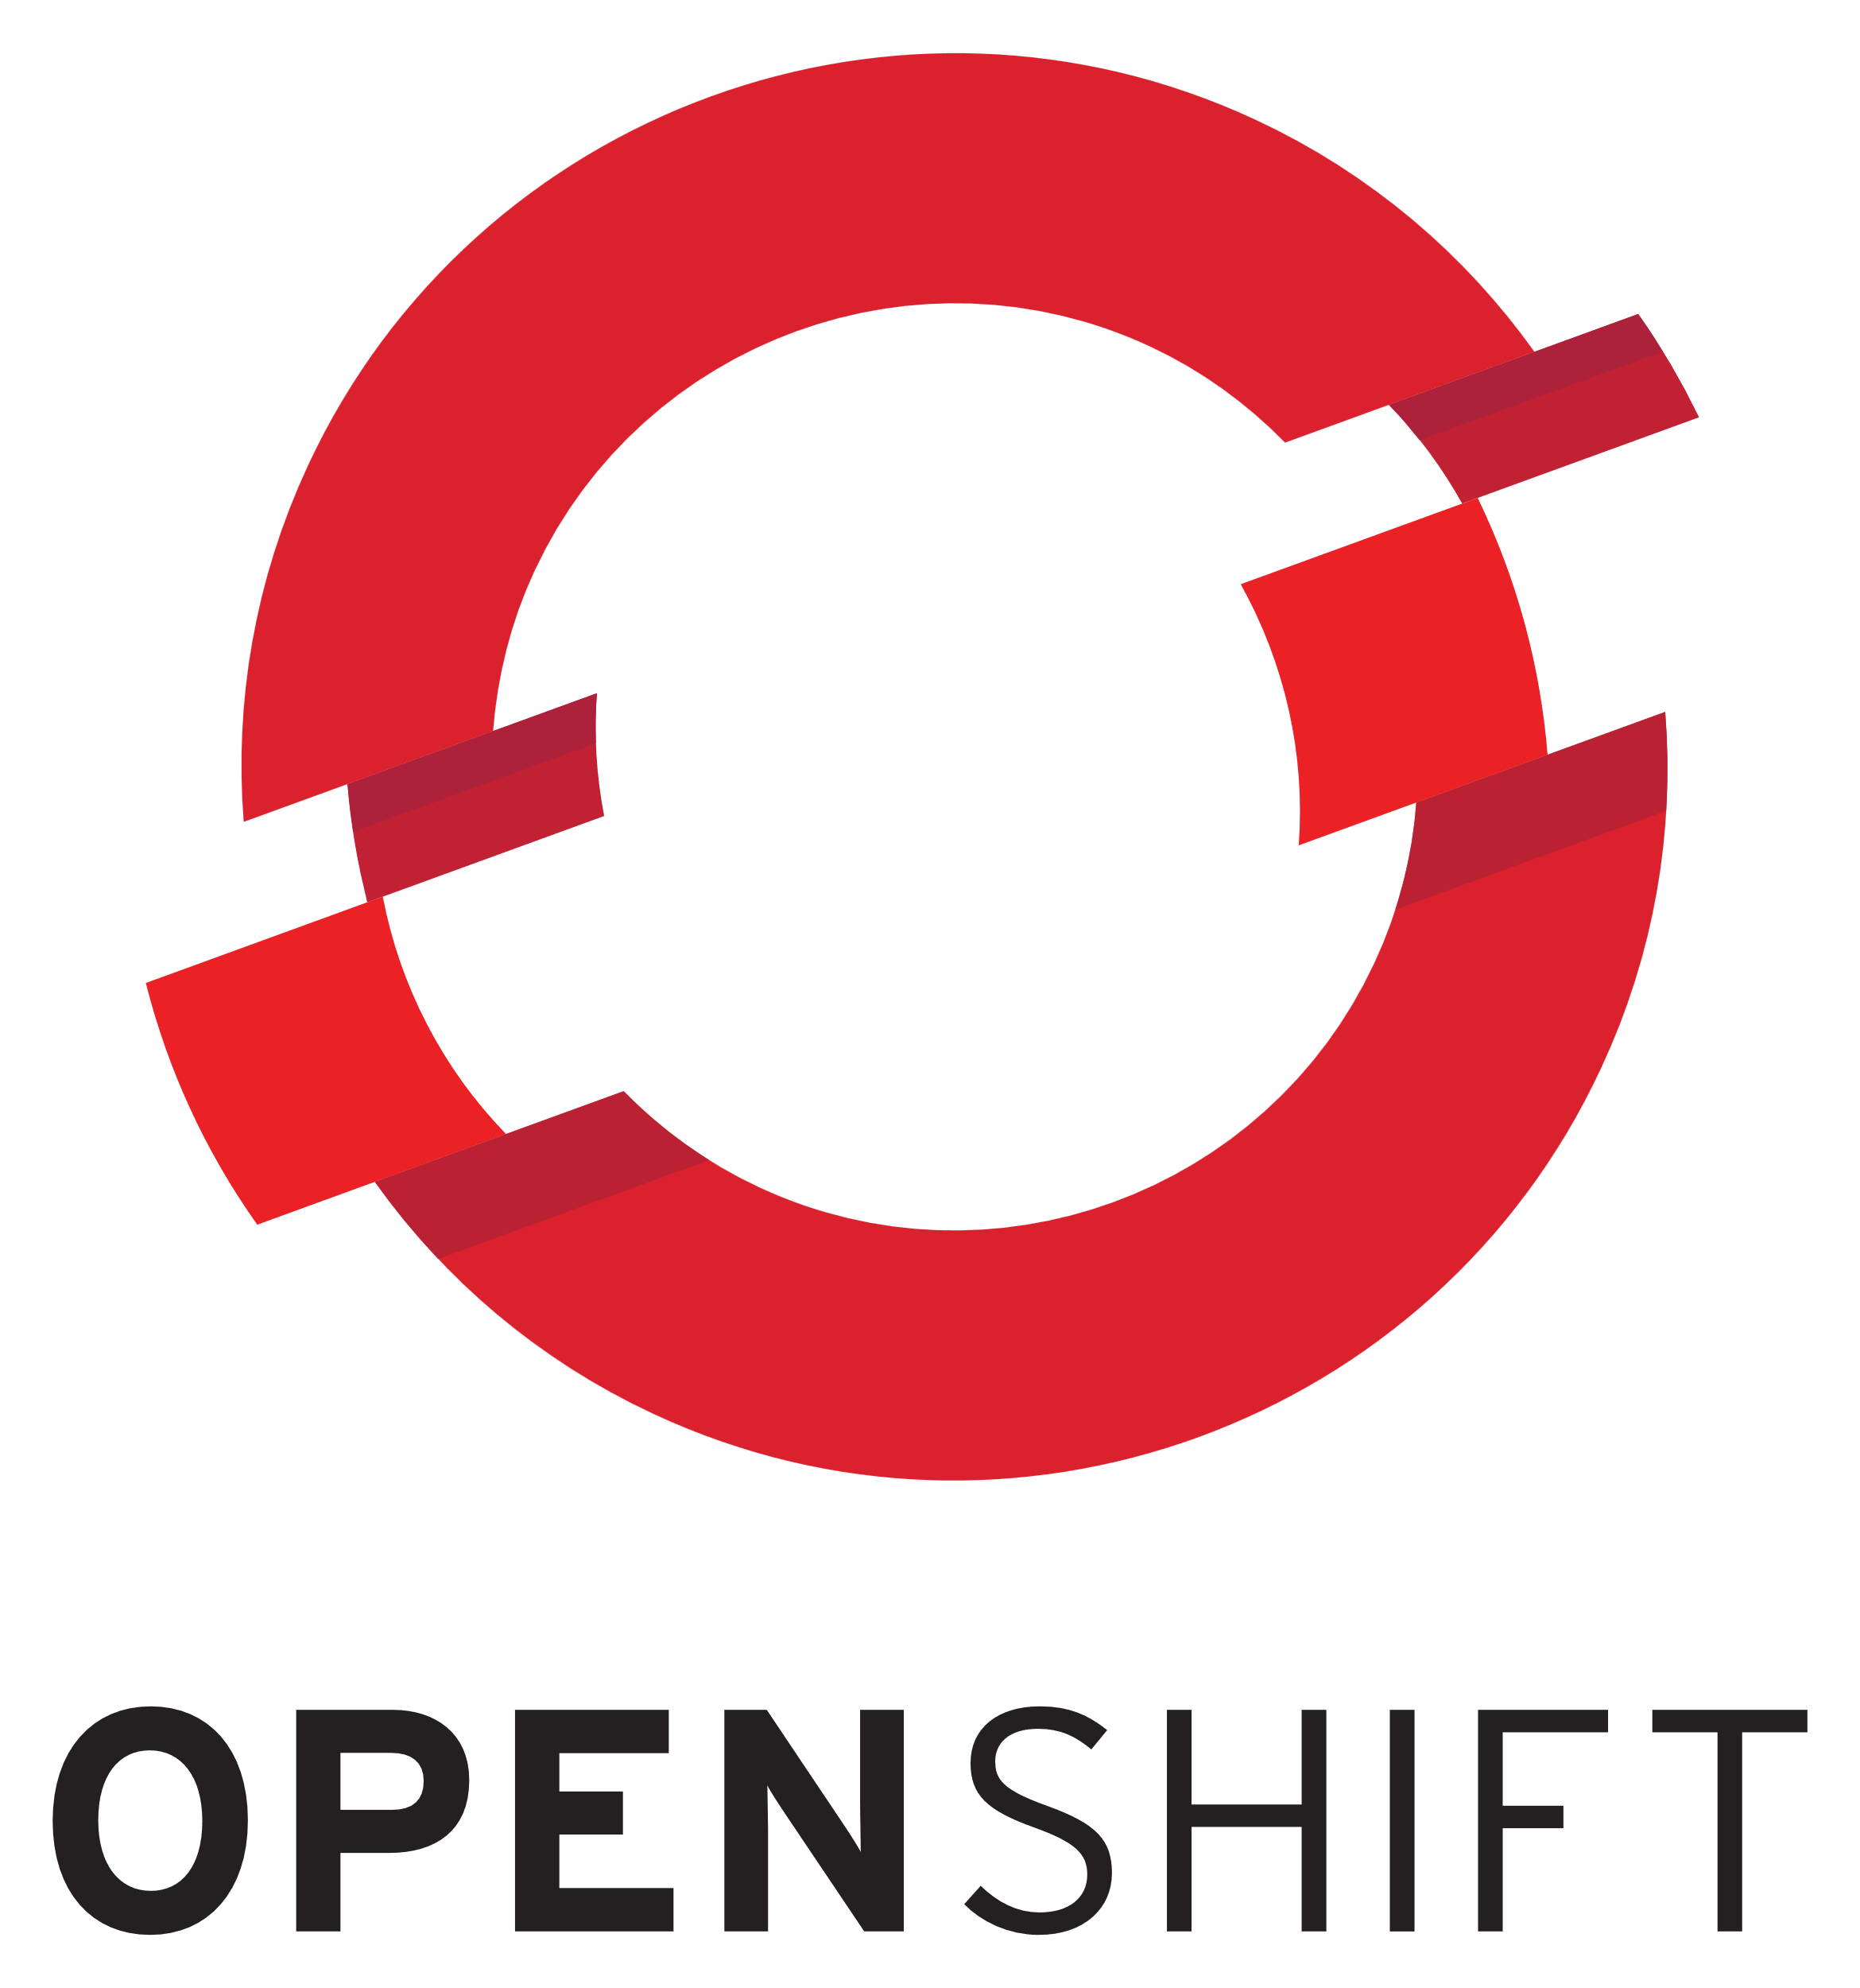

Online backup and restore of CP4D to a different OCP
Prod (Hub) OCP:
Install and configure IBM Storage Fusion
Configure backup for:
Fusion service protection
Cloud Pak for Data Operators
Cloud Pak for Data instance
Prod
DR
DR (Spoke) OCP:
Install and configure IBM Storage Fusion
Configure DR (Spoke) OCP to connect to Prod (Hub) OCP
backup
restore
Restore (From Prod to DR):
Cloud Pak for Data Operators
Cloud Pak for Data instance
S3 Object Store

